Slide 1
Addressing the 3 Rs of Acoustics
With CATS Packs

Slide 2
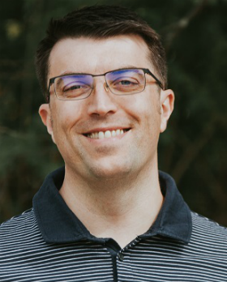
Introductions
NEIL DAVIDSON
Managing Director and Owner
Cinema Acoustic Treatment Systems Ltd
neil@cinema-ats.com
2280

Slide 3
First – Some Exercise!
PLEASE RAISE YOUR HAND IF THE FOLLOWING IS TRUE FOR YOU
I have sold a home cinema
I have sold acoustic design or treatment solutions
I have sold a home cinema with acoustic design or treatment solutions
I have sold acoustic products with a list value over $10,000
I have sold acoustic products with a list value over $50,000
I have used the services of an acoustic/cinema design company

Slide 4
C-ATS Background
Lots of companies offer acoustic treatment products
Typically not designed to meet the challenges of home cinema
No consideration of physical demands on the product
Typically not designed to be commercially appealing!
Several companies offer acoustic design services
Typically adopt a non realistic “no compromise” approach
“Blind the audience with science” leads to overly complex situation
Limited application of best practises in home cinema audio!
What do they do with the first reflection point?!?!?!
What is the right sound balance?

Slide 5
C-ATS Background
After trying many products and service providers I could not find a partner that delivered the products and support I needed for my dealers.
I decided that my only choice was to develop my own solution.
18 months developing the modelling tools
Development of 2 ranges of products
More than 10000 panels sold to date

Slide 6
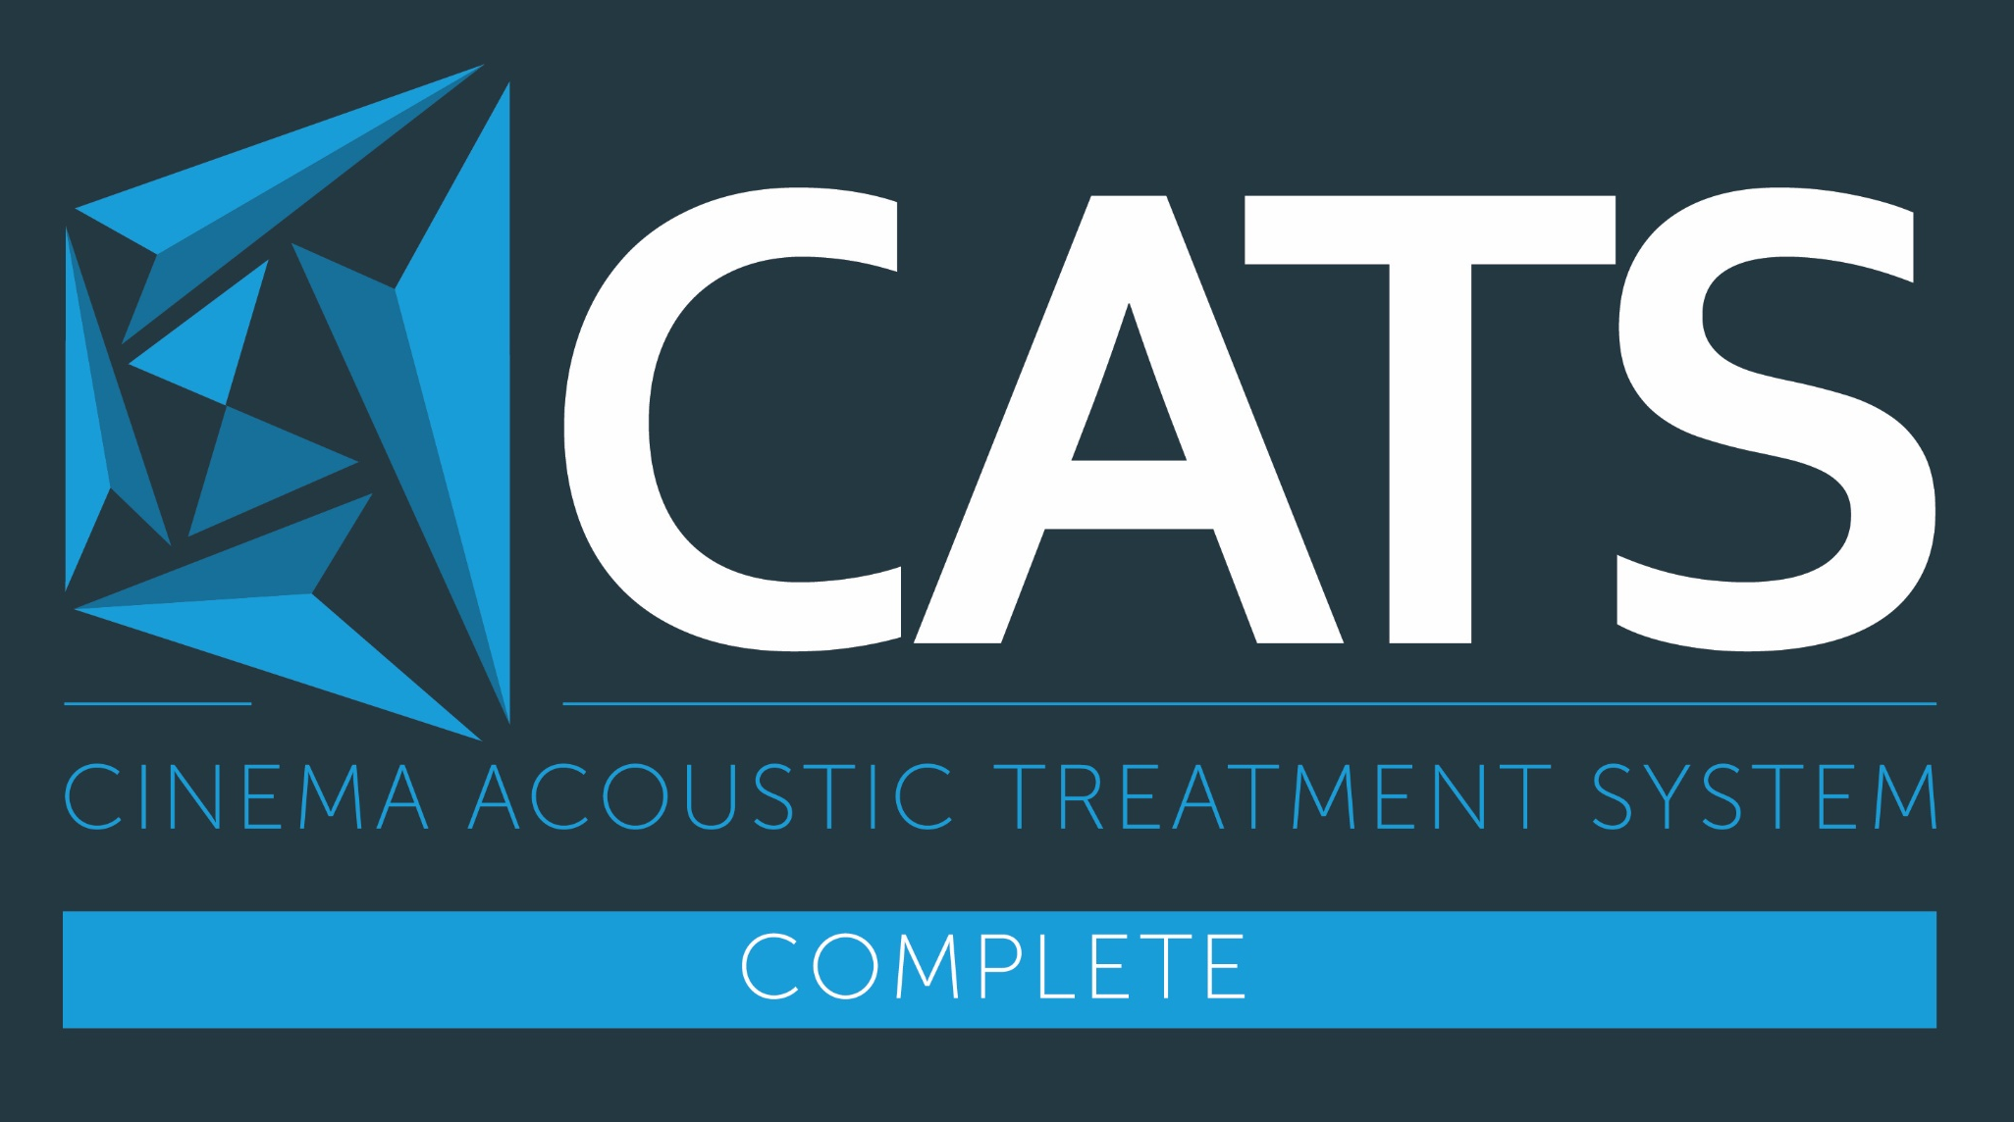
C-ATS Complete
Acoustic enhancement covers the full frequency range
Minimal use of space – only 50mm deep
Components
C-ATS Scattering panels
C-ATS Multipanel
Requires total coverage of each wall surface
Ceiling coverage optional but recommended
Requires bespoke system design
Design $12768, Materials $800 psqm end user

Slide 7
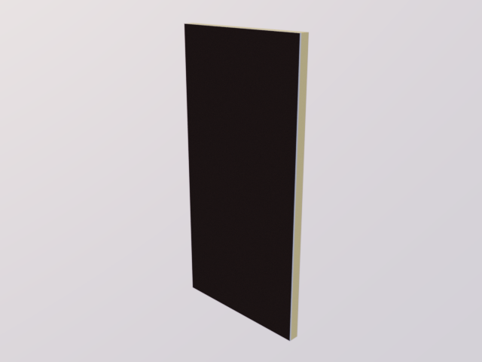
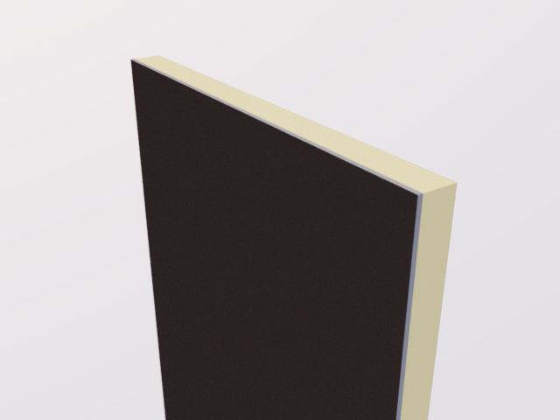
C-ATS Multipanel

Slide 8
C-ATS Packs
Acoustic enhancement covers from 125Hz and above
Minimal use of space – only 50mm deep
Components
C-ATS Scattering panels
C-ATS Foamsorber panels
4 Stage system
(1) Side Walls, (2) Rear Wall, (3) Surrounds, (4) Ceiling
Simple layout guide – no bespoke design required
Materials $1400 per pack end user (24 sqft / 2.1 sqm)

Slide 9
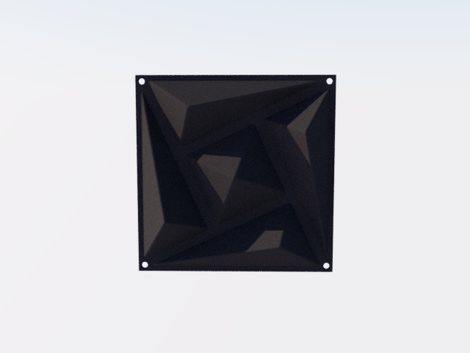
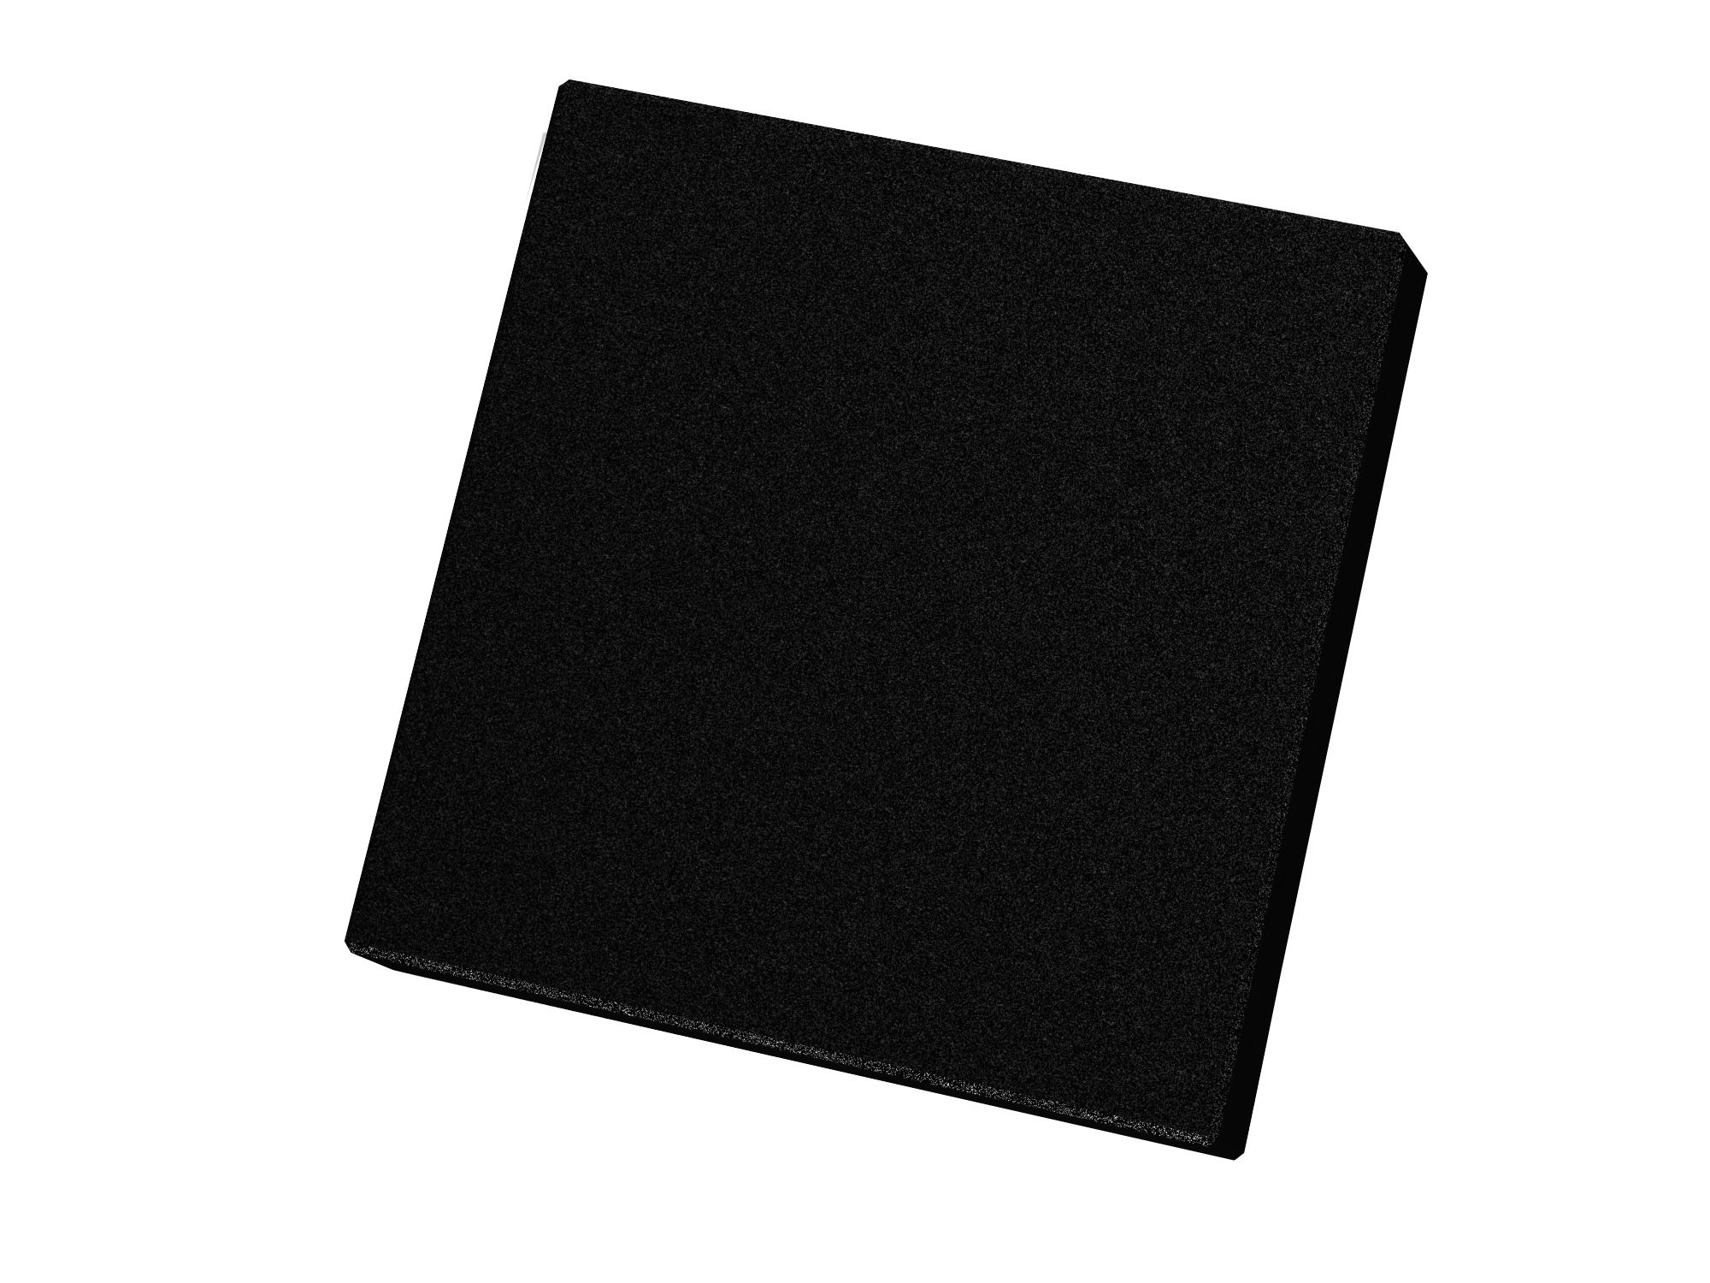
C-ATS Packs

Slide 10
Resonance
Low frequency sounds have a very long wave length.
Up to 20m in home cinema.
As these waves are so long, they are bounced back on themselves by the room boundaries.
The effect of sound waves bouncing repeatedly between the room boundaries is called RESONANCE

Slide 11
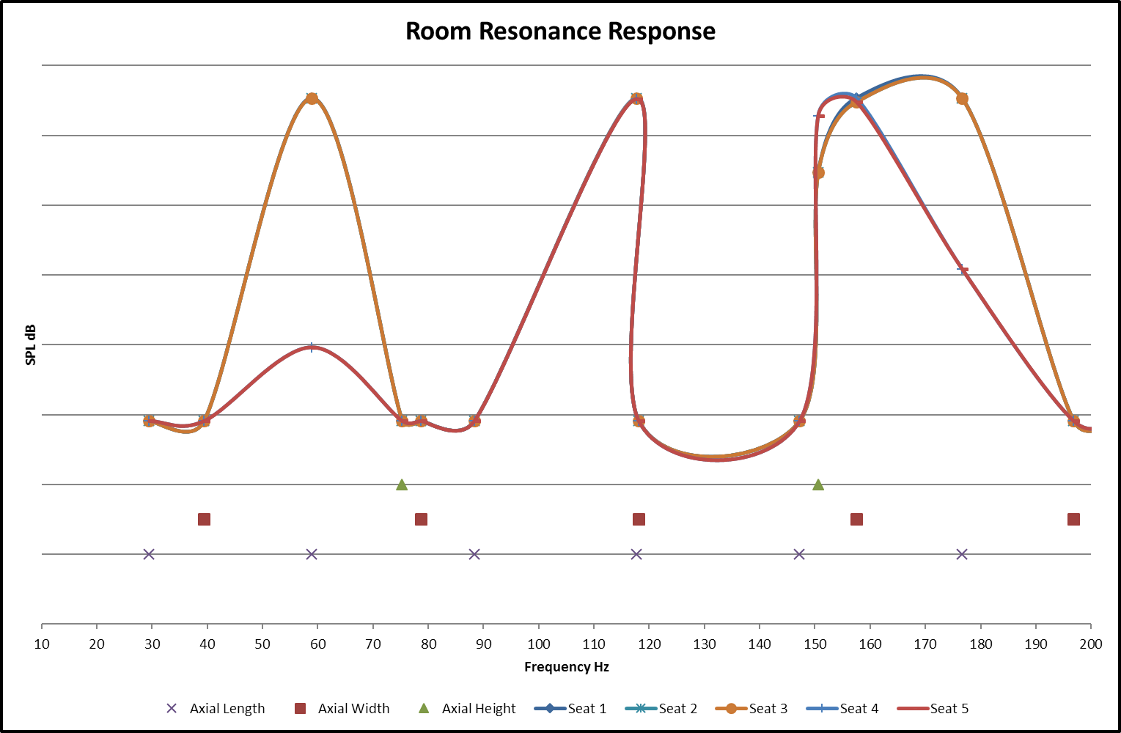
Resonance Chart 1

Slide 12
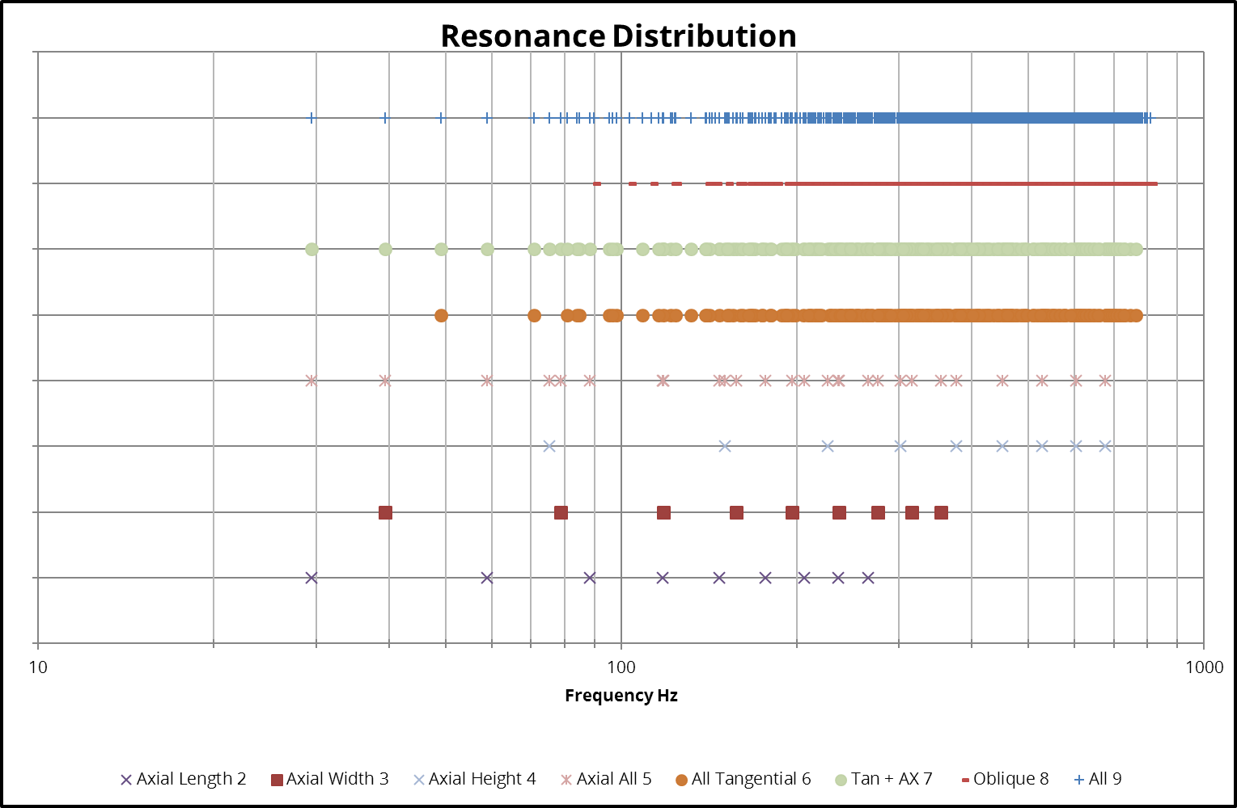
Resonance Chart 2

Slide 13
Treating Resonance
The classical method of treating resonance is to use absorption to prevent waves bouncing off opposing walls
Resonance is a problem at low frequencies hence have very long wavelengths
It is utterly impractical to treat resonance with simple porous absorption panels – particularly if they are wall mounted
C-ATS Packs includes guidelines for subwoofer layout which result in a uniform resonance response at all seats
Some form of electronic EQ is required for perfect results

Slide 14
Reverberation
As the sound waves bounce off the room boundaries they lose some energy but do not disappear completely.
We can hear these repeated sounds for some amount of time after the original sound is over.
The effect of sound waves taking some to decay to silence is called REVERBERATION

Slide 15
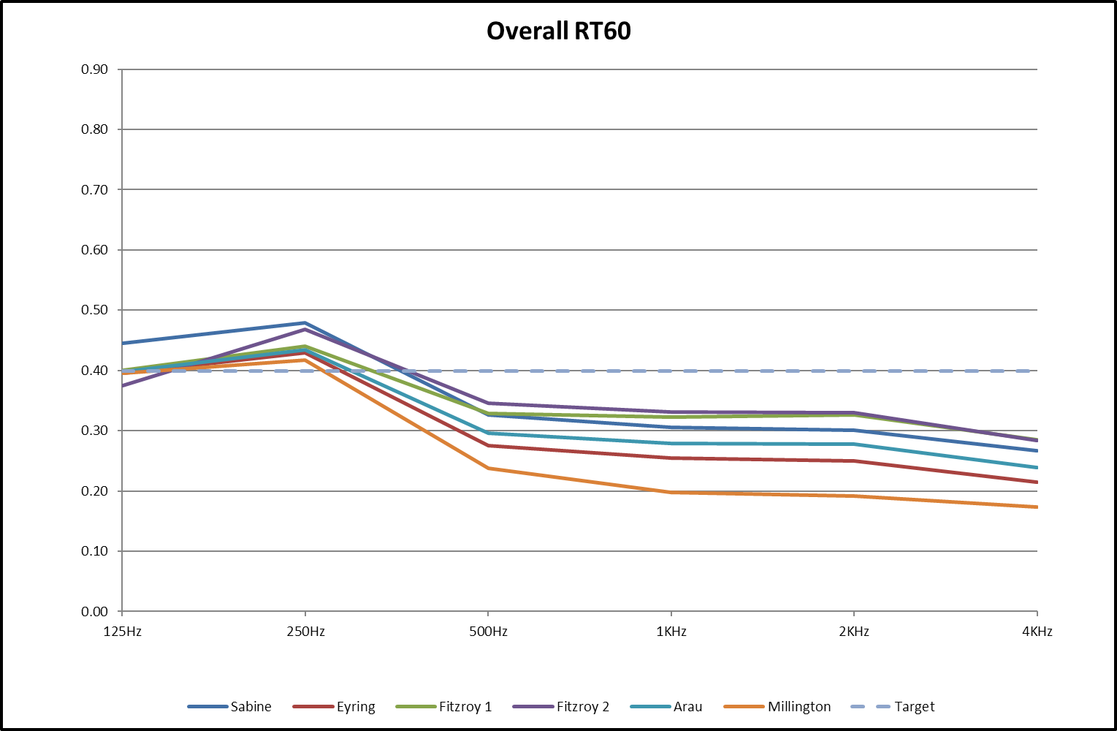
Reverberation Chart

Slide 16
Treating Reverberation
Reverberation time is treated by balancing the amount of absorption with the amount of reflective surfaces.
The target reverberation time is also directly influenced by the room size – larger rooms have a longer decay
C-ATS Packs contain a balance of scattering panels and Foamsorber panels which blend to get us very close to the target decay in most of the rooms where it would be used
Question – should you model the room with all seats in use?

Slide 17
Reflection
Sound waves travel in straight lines and when they hit a boundary they are bounced back in a very specific direction.
This is very much like the behaviour of a pool ball bouncing off the cushion.
Our auditory system uses these spatial cues to work out where sounds are coming from.
The effect of sound waves bouncing off a boundary is called REFLECTION

Slide 18
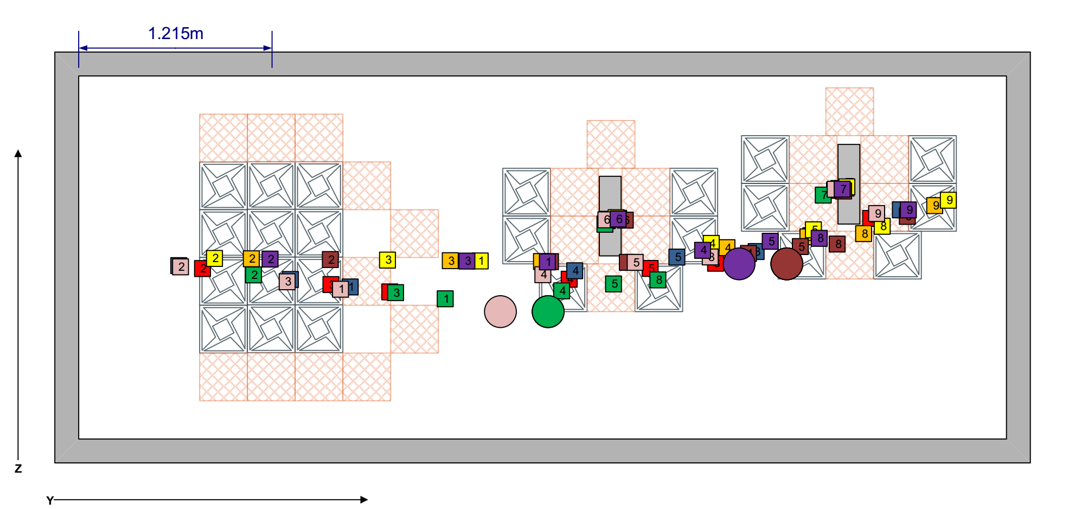
Reflection Chart

Slide 19
Treating Reflection
The classical method of treating reflection is to place a thin porous absorber at the reflection point
For years however, research has indicated that correctly using the first reflection leads to a more spacious sound that most normal listeners prefer
C-ATS Packs places scattering panels at the reflection points. These spread the energy of the reflection enhancing spaciousness whilst also clarifying the direct sound
This is one of the major performance benefits of C-ATS

Slide 20
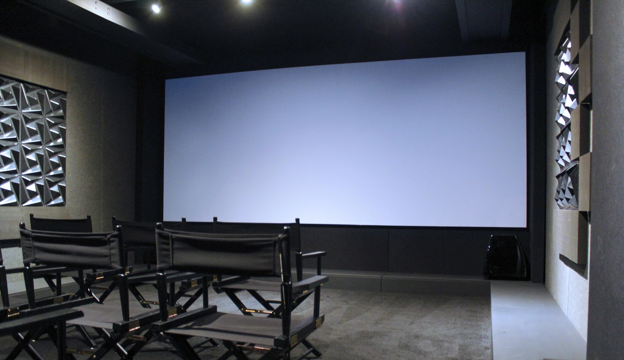
Project Image

Slide 21
Summary
The 3Rs of Acoustics define the rooms impact on sound
Resonance
Reverberation
Reflection
C-ATS Packs have been designed to specifically address each of the 3Rs of acoustics in a straightforward and effective way
C-ATS Packs layout guides allow anyone to deliver a high performance acoustic treatment system without the use of bespoke design services

